Slide 1
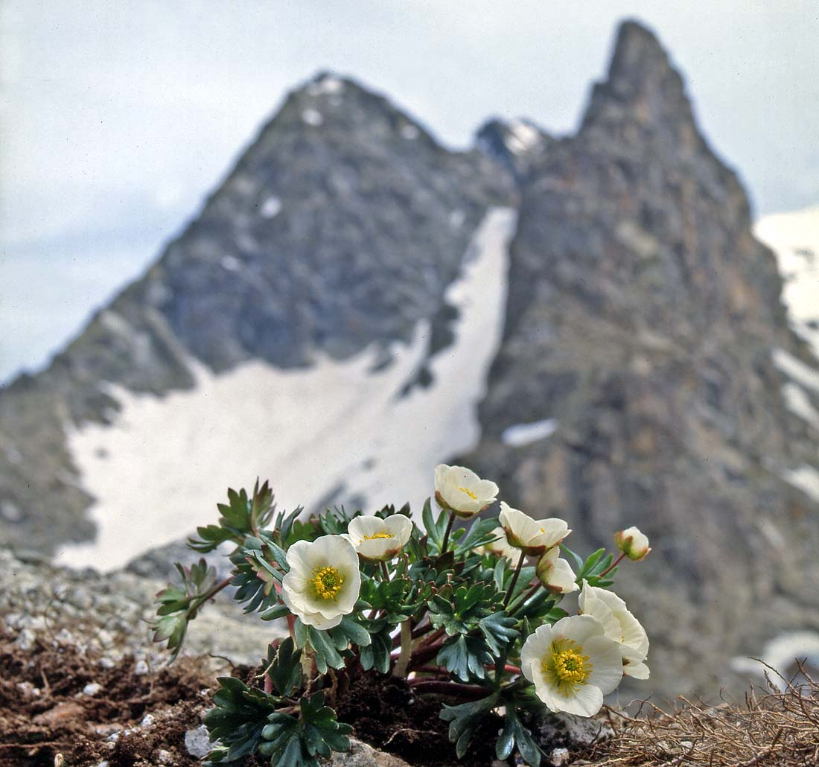

Change in distribution of R. glacialis
Aglaia Io Kazantzidou
Global Change Ecology & Sustainable Development Goals - GCE & SDG

Slide 2
The impact of climate change on plants
Data
Shifts in distribution (latitudinal and altitudinal)
Changes in flowering time and duration
Asynchrony with pollinators
Stress due to climatic parameters changing
Extinction – Change in population dynamics
Source: GBIF
Type: Point data with coordinates (occurrences)

Slide 3
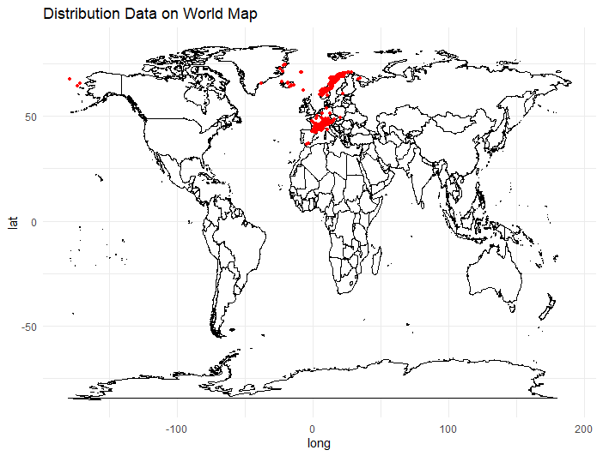
World map with all occurencies world_map <- map_data("world") ggplot() + geom_map(data = world_map, map = world_map, aes(x = long, y = lat, map_id = region), fill = "white", color = "black", size = 0.2) + geom_point(data = Rg, aes(x = decimalLongitude, y = decimalLatitude), color = "red", size = 1) + theme_minimal() + labs(title = "Distribution Data on World Map") # Fetch land polygons land <- ne_download(scale = 110, category = "physical", type = "land", returnclass = "sf")

Slide 4
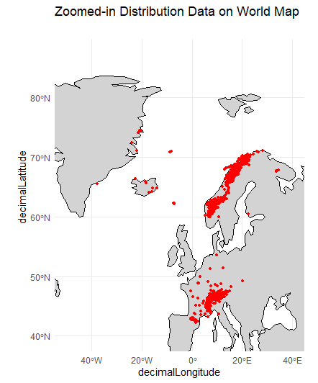
# Zoom-in box where most of distribution is visible bbox <- list(xmin = -50, xmax = 40, ymin = 40, ymax = 90) # Distribution in the zoomed-in box ggplot() + geom_sf(data = land, fill = "lightgray", color = "black") + geom_point(data = Rg, aes(x = decimalLongitude, y = decimalLatitude), color = "red", size = 1) + coord_sf(xlim = c(bbox$xmin, bbox$xmax), ylim = c(bbox$ymin, bbox$ymax)) + theme_minimal() + labs(title = "Zoomed-in Distribution Data on World Map")

Slide 5
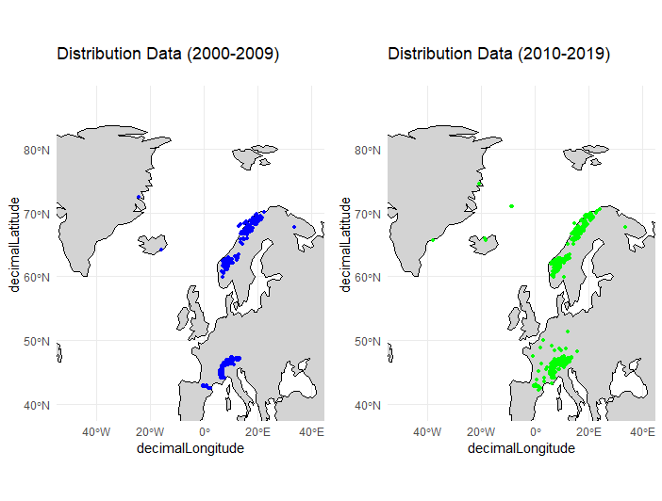
Distribution data for each time period plot_2000_2009 <- ggplot() + geom_sf(data = land, fill = "lightgray", color = "black") + geom_point(data = period_2000_2009, aes(x = decimalLongitude, y = decimalLatitude), color = "blue", size = 1) + coord_sf(xlim = c(bbox$xmin, bbox$xmax), ylim = c(bbox$ymin, bbox$ymax)) + theme_minimal() + labs(title = "Distribution Data (2000-2009)") plot_2010_2019 <- ggplot() + geom_sf(data = land, fill = "lightgray", color = "black") + geom_point(data = period_2010_2019, aes(x = decimalLongitude, y = decimalLatitude), color = "green", size = 1) + coord_sf(xlim = c(bbox$xmin, bbox$xmax), ylim = c(bbox$ymin, bbox$ymax)) + theme_minimal() + labs(title = "Distribution Data (2010-2019)") grid.arrange(plot_2000_2009, plot_2010_2019, ncol = 2)

Slide 6
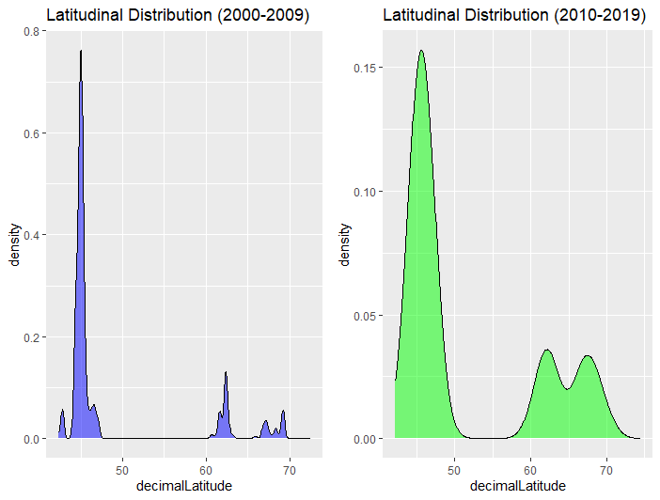
Latitudinal distribution during the two periods # Density plot for the latitudinal distribution in 2000-2009 lat1 <- ggplot(period_2000_2009, aes(x = decimalLatitude)) + geom_density(fill = "blue", alpha = 0.5) + labs(title = "Latitudinal Distribution (2000-2009)") # Density plot for the latitudinal distribution in 2010-2019 lat2 <- ggplot(period_2010_2019, aes(x = decimalLatitude)) + geom_density(fill = "green", alpha = 0.5) + labs(title = "Latitudinal Distribution (2010-2019)") # Display the two density plots side by side grid.arrange(lat1, lat2, ncol = 2)

Slide 7
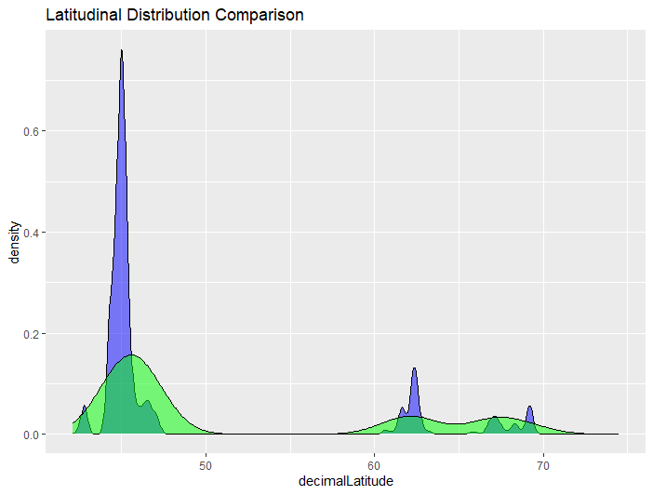
# Overlay the density plots for latitude combined_plot_latitude <- lat1 + geom_density(data = period_2010_2019, aes(x = decimalLatitude), fill = "green", alpha = 0.5) + labs(title = "Latitudinal Distribution Comparison") # Display the combined plot print(combined_plot_latitude)

Slide 8
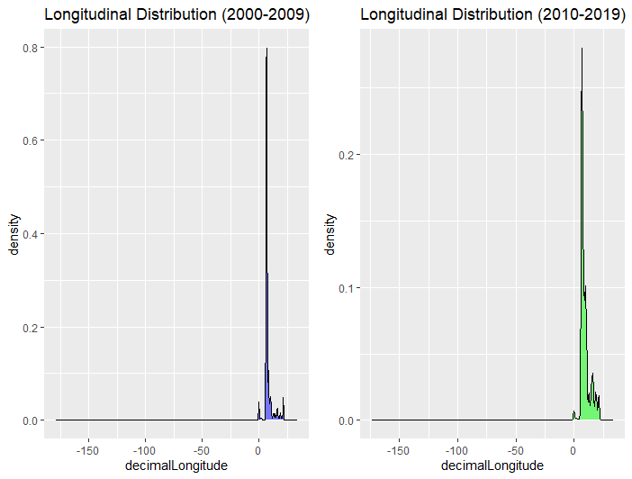
Longitudinal distribution during the two periods: # Density plot for the longitudinal distribution in 2000-2009 long1 <- ggplot(period_2000_2009, aes(x = decimalLongitude)) + geom_density(fill = "blue", alpha = 0.5) + labs(title = "Longitudinal Distribution (2000-2009)") # Density plot for the longitudinal distribution in 2010-2019 long2 <- ggplot(period_2010_2019, aes(x = decimalLongitude)) + geom_density(fill = "green", alpha = 0.5) + labs(title = "Longitudinal Distribution (2010-2019)") # Display the two density plots side by side grid.arrange(long1, long2, ncol = 2)

Slide 9
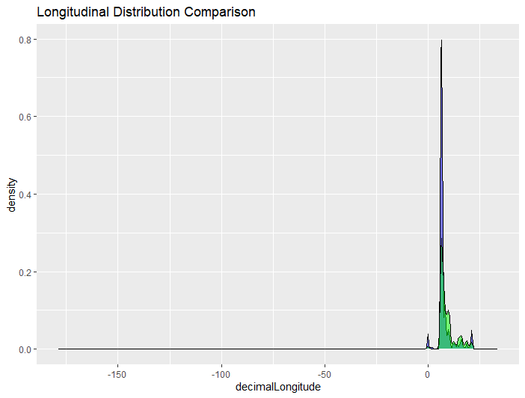
# Overlay the density plots for longitude combined_plot_longitude <- long1 + geom_density(data = period_2010_2019, aes(x = decimalLongitude), fill = "green", alpha = 0.5) + labs(title = "Longitudinal Distribution Comparison") # Display the combined plot print(combined_plot_longitude)

Slide 10
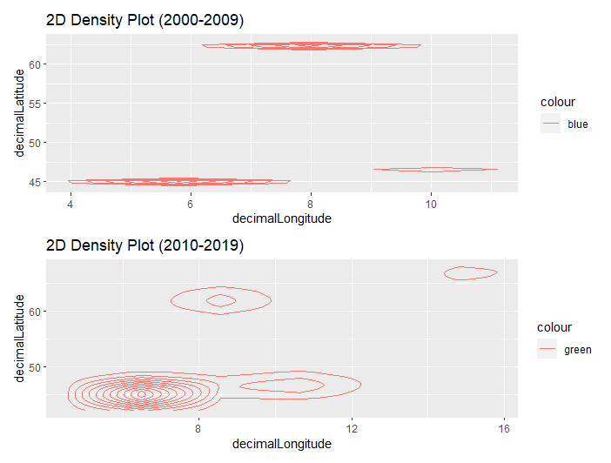
2D density plot to show the shift between the two distributions: # Create 2D density plot for 2000-2009 plot_2000_2009_density <- ggplot(period_2000_2009, aes(x = decimalLongitude, y = decimalLatitude)) + geom_density_2d(aes(color = "blue"), size = 0.5) + labs(title = "2D Density Plot (2000-2009)") # Create 2D density plot for 2010-2019 plot_2010_2019_density <- ggplot(period_2010_2019, aes(x = decimalLongitude, y = decimalLatitude)) + geom_density_2d(aes(color = "green"), size = 0.5) + labs(title = "2D Density Plot (2010-2019)") # Combine the 2D density plots combined_density_plot <- plot_2000_2009_density + plot_2010_2019_density + plot_layout(nrow = 2, byrow = TRUE) # Display the combined plot print(combined_density_plot)

Slide 11
Results
Latitudinal Shift between the two periods 2000-2009 and 2010-2019
Distribution seems to expand North-wise

